Slide 1
Algorithms and templates

Slide 2
Outline
In this lesson, we will:
Introduce the idea of algorithms
Describe how we can generalize our algorithms for arbitrary data types

Slide 3
To this point…
Up to this point, we have focused on programming syntax
Basic syntax
Functions, conditional statements, for-loops and while loops
The structured programming theorem
Console input and output
Data types and binary
Arithmetic, comparison, logic, assignment and bit-wise operators
Arrays and pointers

Slide 4
What is next?
The next step is to look at how to solve problems
Recursion and recursive algorithms
Searching arrays
Sorting arrays

Slide 5
Recursive algorithms
A recursive algorithm is one that solves a larger problem by first solving a smaller or easier problem, and then using that solution to solve the larger problem

Slide 6
Searching algorithms
Given an array, we may wish to find whether or not that array contains a specific value, and if so, which entry that value occupies
A linear search can find an entry in an arbitrary array
If the array is sorted, it is possible to find the entry more quickly than with a linear search

Slide 7
Sorted arrays
The integers and real numbers are linearly ordered:
Given to integers or real numbers a and b, then exactly one of these statements is correct:
a < b a = b a > b
An array a is said to be sorted if
a[i] <= a[j]
whenever i <= j for any two entries in the array
More easily:
a₀ ≤ a₁ ≤ a₂ ≤ a₃ ≤ ··· ≤ a_{n – 2} ≤ a_{n – 1}
If a_{i} > a_{j} even though i < j, we say the two entries form an inversion

Slide 8
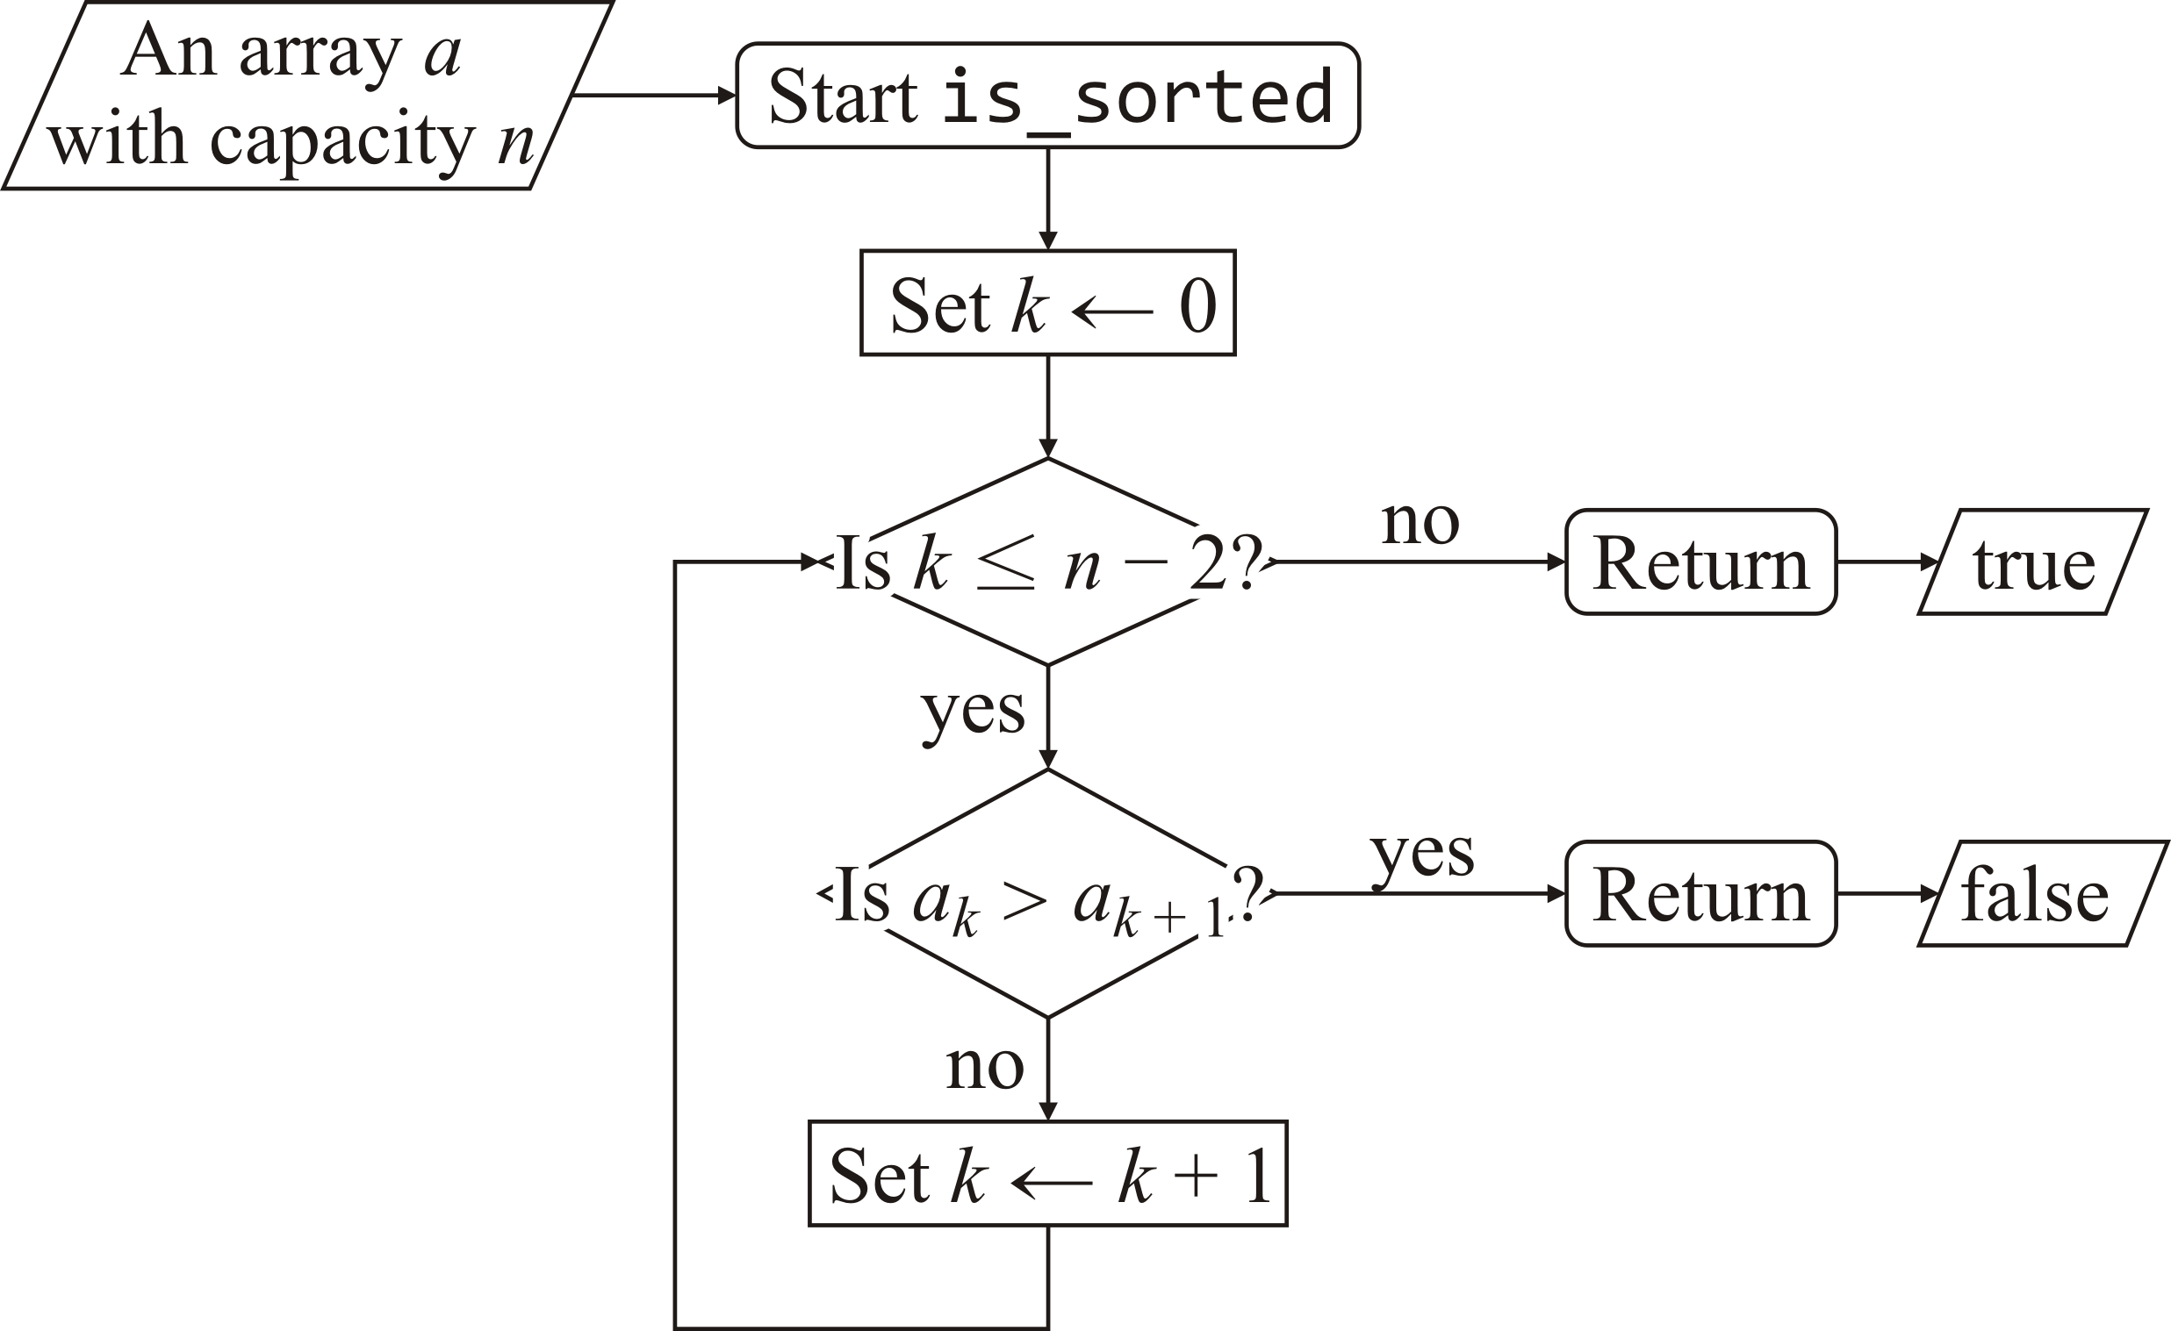
Is an array sorted?
Here is the flow chart for checking if an array is sorted:

Slide 9
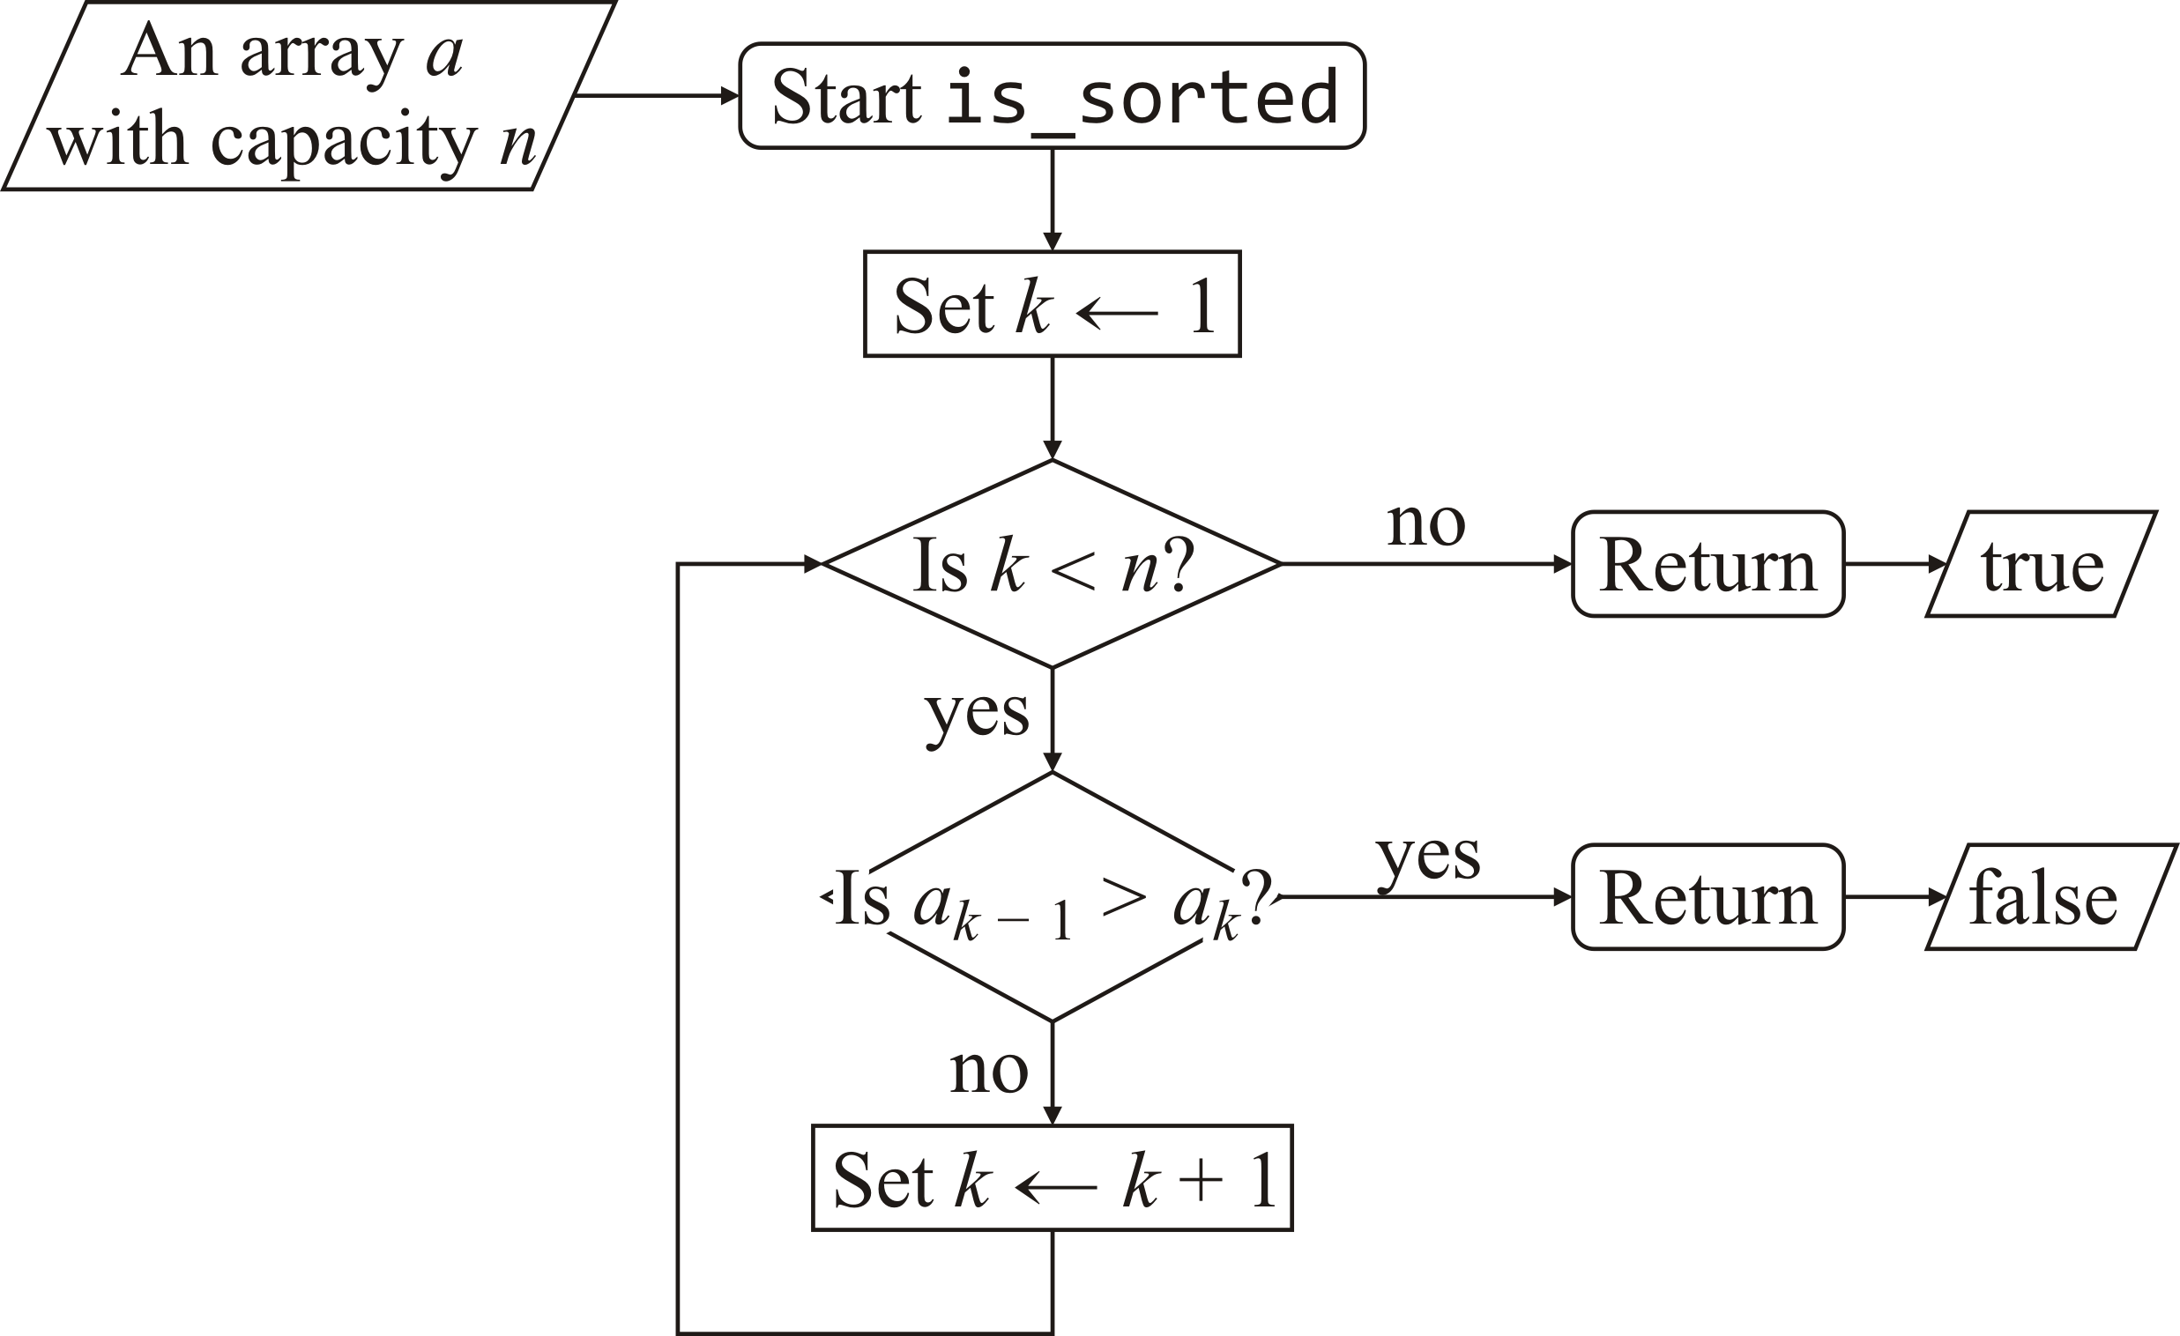
Is an array sorted?
Here is a slight variation: k goes from 1 up to but not including the capacity

Slide 10
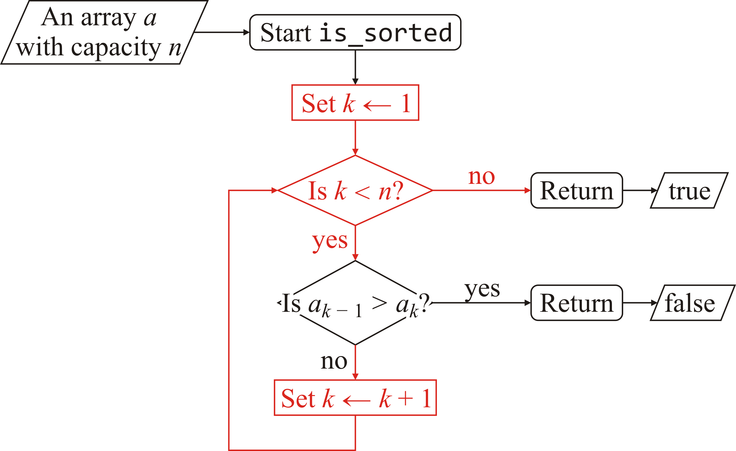
Is an array sorted?
Our function will use a for loop:
bool is_sorted( double const array[],
std::size_t const capacity ) {
for ( std::size_t k{1}; k < capacity; ++k ) {
}
// No inversions were found
return true;
}

Slide 11
Is an array sorted?
Inside the loop, we compare consecutive entries:
bool is_sorted( double const array[],
std::size_t const capacity ) {
for ( std::size_t k{1}; k < capacity; ++k ) {
if ( array[k - 1] > array[k] ) {
// An inversion is found--the array is not sorted
return false;
}
}
// No inversions were found
return true;
}

Slide 12
Is an array sorted?
Like our linear search:
If you double the capacity of an array, it will take twice as long to determine if the array is sorted
If you halve the capacity, it will take half as long
Make the capacity 10 times larger, it will take 10 times as long to run
We must compare each pair, for only two entries may be out of order
int array[20]{ 2, 15, 23, 39, 42, 57, 63, 71, 80, 95,
103, 119, 125, 122, 139, 148, 150, 163, 183, 222};

Slide 13
Is a sub-array sorted?
As with a linear search on a sub-array, we will verify that the sub-array is sorted from the index begin up to but not including the index end:
bool is_sorted( double const array[],
std::size_t const begin,
std::size_t const end ) {
for ( std::size_t k{begin + 1}; k < end; ++k ) {
if ( array[k - 1] > array[k] ) {
return false;
}
}
return true;
}

Slide 14
Is a sub-array sorted?
Again, this follows the C++ approach to array indexing
The entire array can be searched either by
is_sorted( some_array, capacity );
is_sorted( some_array, 0, capacity );
Indeed, we should re-implement the first function to call the second:
bool is_sorted( double const array[],
std::size_t const capacity ) {
// Call the more general 'is_sorted' function
return is_sorted( array, 0, capacity );
}

Slide 15
Sorting algorithms
This array is not sorted:
int array[10]{82, 25, 32, 85, 16, 36, 40, 4, 28, 7};
Goal: Write an algorithm that converts an array to one that is sorted:
Such an algorithm is described as a sorting algorithm
0 | 1 | 2 | 3 | 4 | 5 | 6 | 7 | 8 | 9
82 | 25 | 42 | 85 | 16 | 32 | 42 | 4 | 28 | 7
0 | 1 | 2 | 3 | 4 | 5 | 6 | 7 | 8 | 9
4 | 7 | 16 | 25 | 28 | 32 | 42 | 42 | 82 | 85

Slide 16
Sorting algorithms
There are many different sorting algorithms
selection sort insertion sort shell sort
comb sort gnome sort heap sort
merge sort quick sort bucket sort
radix sort cube sort counting sort
block sort
Some are funny:
bozo sort bogo sort stooge sort
Some sorting algorithms are worse than others
If you have ever learned bubble sort, forget it now…
Even Senator Obama knew not to use bubble sort:
https://www.youtube.com/watch?v=koMpGeZpu4Q

Slide 17
Sorting algorithms
We will look at three algorithms:
Selection sort
Insertion sort
Counting sort
Each algorithm has its own benefits and drawbacks:
There is no perfect one-size-fits-all sorting algorithm
Except bubble sort: its only redeeming feature is a memorable name
In your algorithms course, you will see faster algorithms:
Heap sort
Merge sort
Quick sort

Slide 18
Sorting algorithms
The function declaration of each sorting algorithm will be similar:
void algorithm_name( double array[],
std::size_t const capacity );
void algorithm_name( double array[],
std::size_t const begin,
std::size_t const end );
Only the capacity or end points are declared constant
The entries of the array will be changed by the algorithm

Slide 19
Templates
One weakness we will find with these algorithms is that they must all be hard-coded for one particular data type
We will describe how templates can be used to generalize these algorithms

Slide 20
After this course?
Following this course, you will then look forward to a course specifically on algorithms and data structures
Stacks, queues and deques
Trees and search trees
Priority queues
Hash tables
Graph algorithms
Algorithm design
Theory of computation

Slide 21
Summary
Following this lesson, you now
Have reviewed what we have seen before
Have an introduction to the next sequence of lectures
Understand how these topics will be discussed in future courses

Slide 22
References
[1] Wikipedia:
https://en.wikipedia.org/wiki/Algorithms

Slide 23



Colophon
These slides were prepared using the Georgia typeface. Mathematical equations use Times New Roman, and source code is presented using Consolas.
The photographs of lilacs in bloom appearing on the title slide and accenting the top of each other slide were taken at the Royal Botanical Gardens on May 27, 2018 by Douglas Wilhelm Harder. Please see
https://www.rbg.ca/
for more information.

Slide 24
Disclaimer
These slides are provided for the ece 150 Fundamentals of Programming course taught at the University of Waterloo. The material in it reflects the authors’ best judgment in light of the information available to them at the time of preparation. Any reliance on these course slides by any party for any other purpose are the responsibility of such parties. The authors accept no responsibility for damages, if any, suffered by any party as a result of decisions made or actions based on these course slides for any other purpose than that for which it was intended.

